Slide 1
Project Name : HR Analytics (Employee Retention)
Group Members;

Slide 2
INTRODUCTION: HR Analytics involves the collection and analysis of HR-related data, including employee records, performance metrics, and other key data points. By leveraging advanced analytical tools and techniques, HR Analytics helps organizations gain valuable insights into workforce trends and HR processes.
OBJECTIVE: The aim of this project is to analyze employee retention and attrition rates with the organization and provide insights to the HR team for developing effective retention strategies. Through data analysis and visualizations, we will identify factors that contribute to :
Employee turnover and attrition.
Evaluate the effectiveness of existing retention strategies.
To Verify the satisfaction level of employee in the organization.
Provide recommendations to improve employee retention.
SCOPE: - Data Collection: Employee records, salaries, job satisfaction, attrition status.
- Data Analysis: Identifying trends in income and attrition.
- Visualization: Creating dashboards for better insights.
- Recommendations: Providing HR strategies based on findings.

Slide 3
PROBLEM STATEMENT:
Average Attrition rate for all Departments
Average Hourly rate of Male Research Scientist
Attrition rate Vs Monthly income stats
Average working years for each Department
Job Role Vs Work life balance
Attrition rate Vs Year since last promotion relation

Slide 4
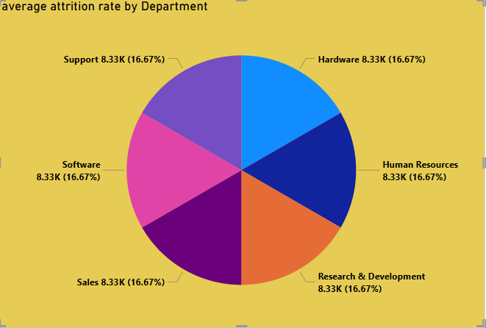
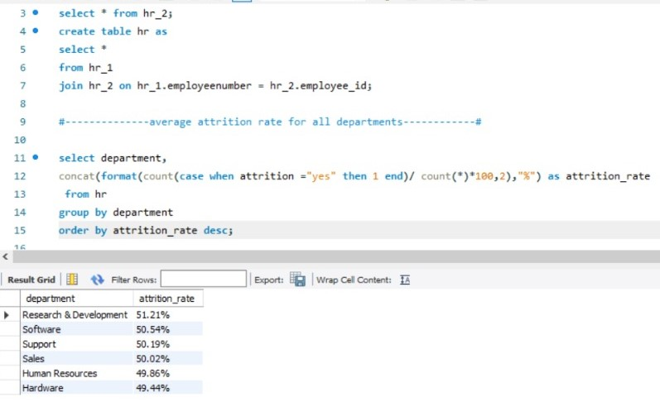
KPI 1: Average Attrition Rate for all Departments - This KPI is to find out the relationship between each department and its attrition rate and here attrition rate is higher for research and Development Department where as lowest for Hardware Department.
From This we can clearly say that the attrition rate of employees for every department is almost 50% from which we get to know that the attrition rate of employees does not depend on department. So, irrespectively of the department almost 50% of the employees are leaving the company.
From this calculation and visualization, we concluded that we must make strong strategies to minimize attrition rate and improve our company’s Employee retention so that we can balance the company ‘s growth and right talent.

Slide 5
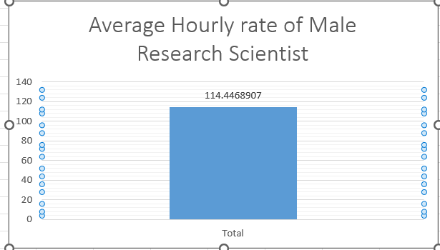
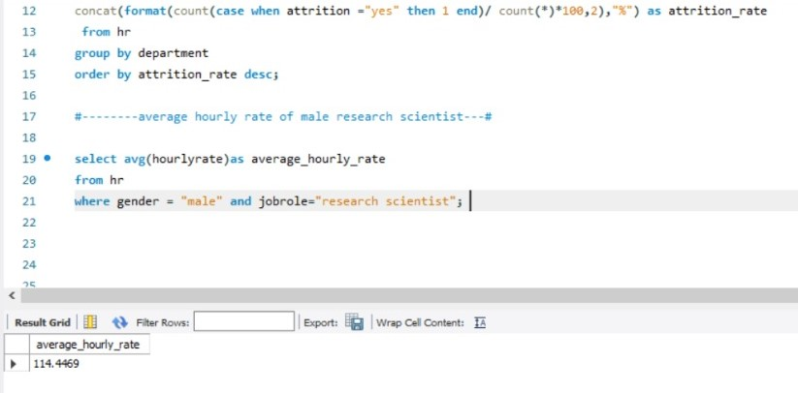
KPI 2: Average Hourly rate of male Research Scientist – This KPI is to find out the average hourly rate of male Research Scientists.
As it is found that the Average rate of male Research Scientist is 114.449%

Slide 6
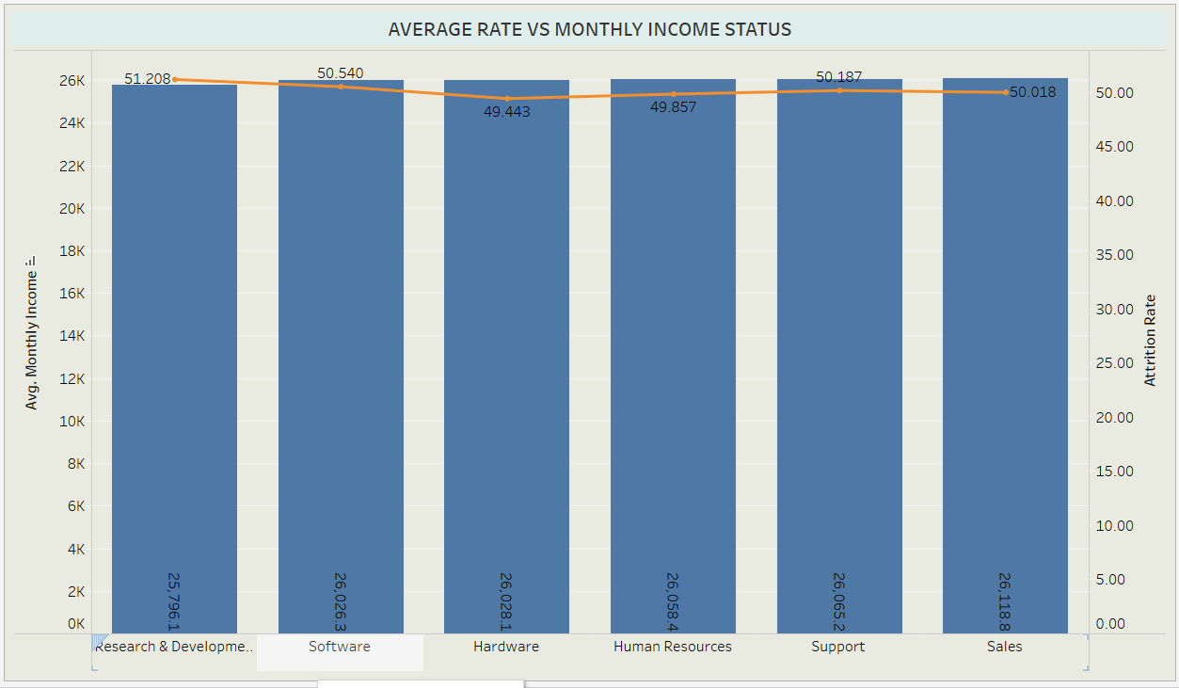
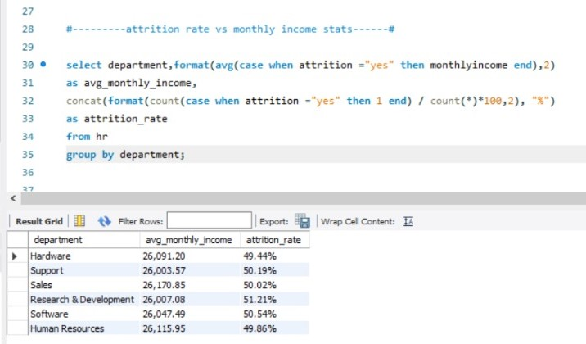
KPI 3: Attrition Rate Vs Monthly Income Status
Based on our Analysis and Visualization, it is evident that the Hardware Department has the lowest attrition rate of 49.44% with and average monthly income of Rs 26,091.20. on the other hand, the Research and development Department has the highest attrition rate of 51.21%, with an average monthly income of Rs 26,007.08.

Slide 7
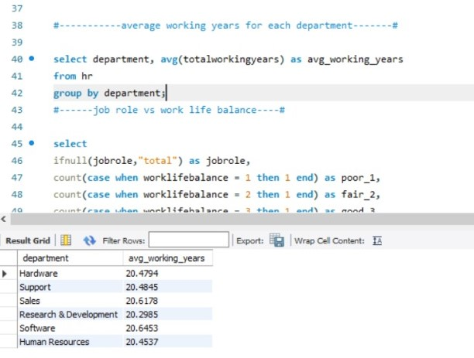
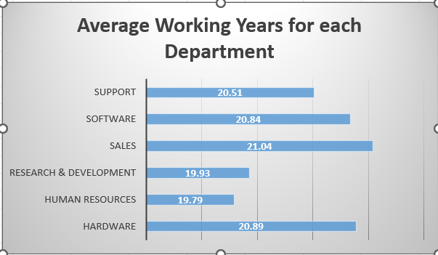
KPI 4: Average Working years for each department
From this we can see the average working years in Software department is high as compared to the rest of the departments and lowest is for Research & Development Department.
From the Analysis we can conclude that average working years is approximately 20 for all the departments.

Slide 8
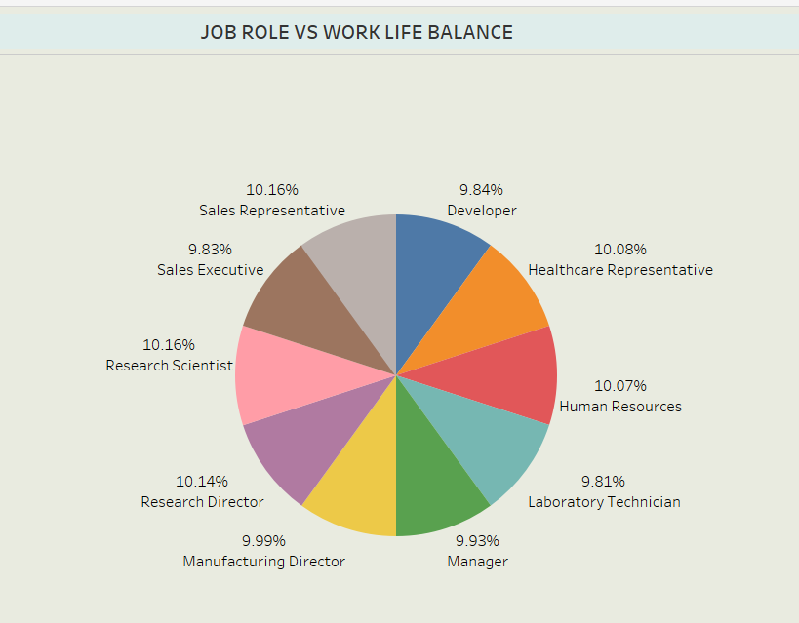
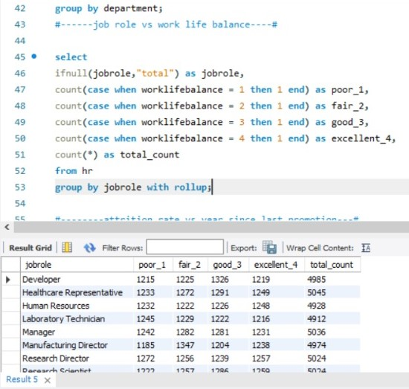
KPI 5: Job Role Vs Work Life Balance for Total Employees.
For Research Scientists, Healthcare representatives and developers have good work life balances also for human resources the work life balance is excellent.
For the Sales representative, Managers, manufacturing Directors and the Sales Executives have fair work life Balances.
From this Analysis we can conclude that for Research Directors and the laboratory technicians have poor work life balances.

Slide 9
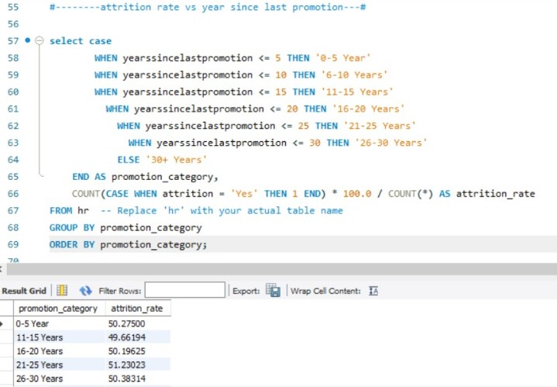
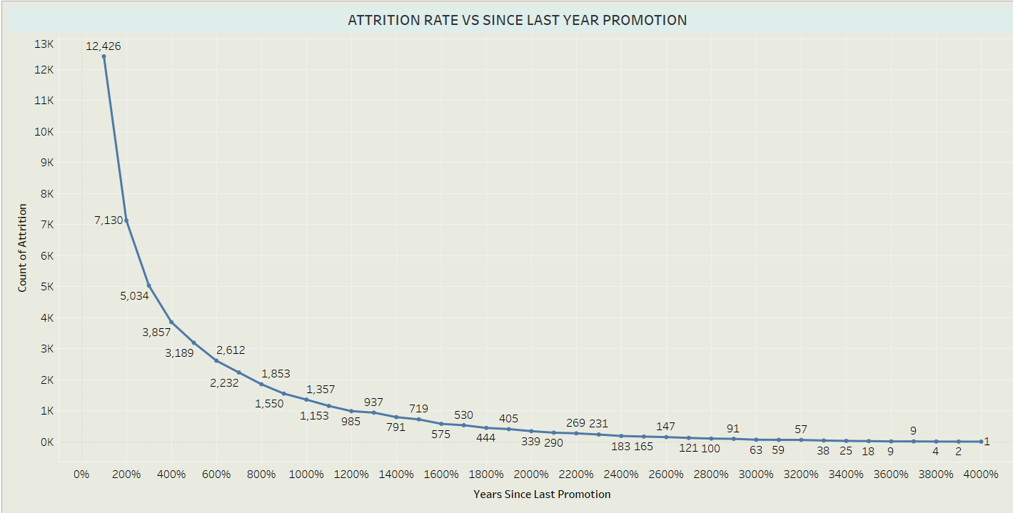
KPI 6: Attrition Rate Vs Years Since Last Promotion - From this we find out that :
For 0-5 Years since last Year Promotion interval Research & development and Hardware Departments has highest and lowest attrition rate respectively.
For 6-10 Years since last year promotion interval Human Resource and software department has highest and lowest attrition rate respectively.
For 11-15 Years since last promotion interval support and sales department has highest and lowest attrition rate respectively.
For 16-20 Years since last promotion interval Software & Hardware department has highest and lowest attrition respectively.
For 21-25 Years since last promotion interval Software and support department has highest and lowest attrition respectively.
For 26-30 Years since last promotion interval Support and Human Resource Department has highest and lowest attrition respectively.
For Above 30 Years since last promotion interval software and human resources departments has highest and lowest attrition respectively.

Slide 10
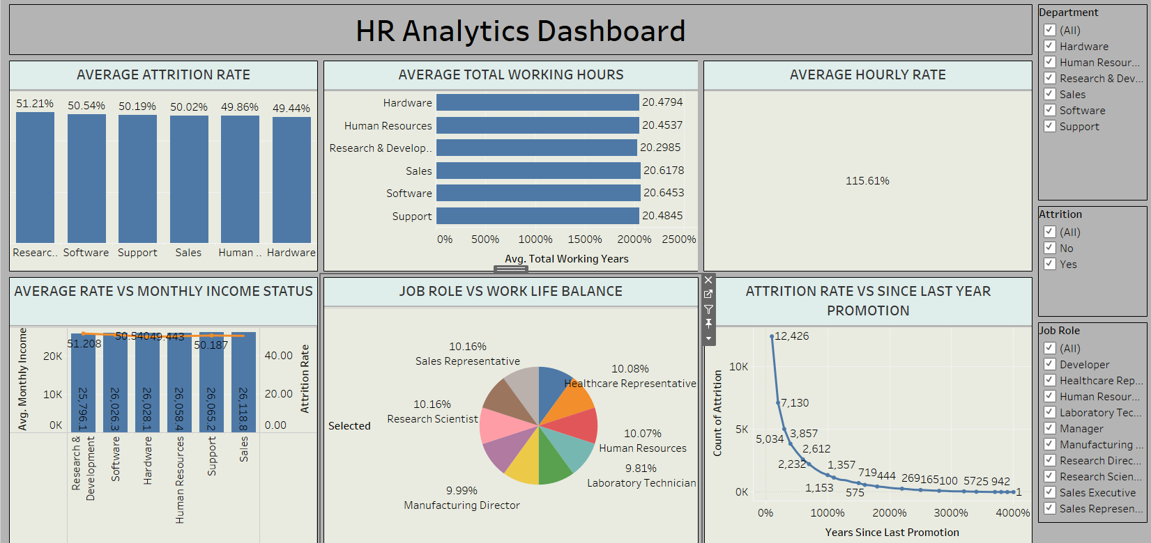
Tableau Dashboard

Slide 11
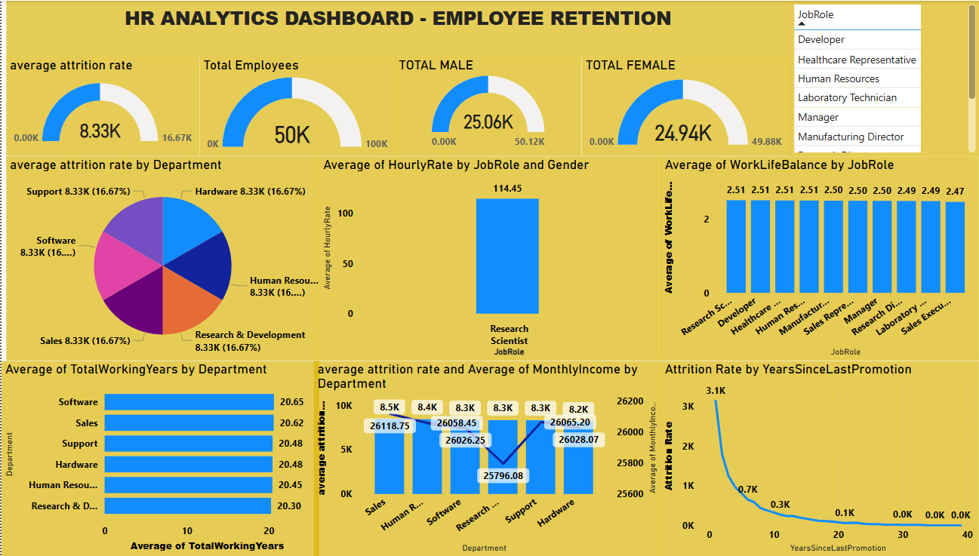
Power BI Dashboard

Slide 12
Conclusion :
Conduct stay interviews: Instead of exit interviews, conduct stay interviews with employees to gather feedback about the job.
Improve employee engagement: Implement initiatives to improve employee engagement, such as regular feedback, recognition and rewards programs, and opportunities for career growth.
Create a positive work environment: Foster a positive work environment by promoting a culture of respect, inclusivity, and teamwork. Encourage open communication and collaboration among employees.
Address workload issues: Ensure employees have manageable workloads by regularly monitoring and adjusting workloads to prevent burnout and overwhelm.
Address pay and compensation issues: Ensure that employees receive fair pay and compensation for them work and to find out what motivates an employee to continue to work in an organization.
THANK YOU

